Slide 1
Reading in KS1
Mrs Randon

Slide 2
Read, Write Inc.
Continues in KS1
Differentiated Groups
Learning set 1, 2 and 3 sounds
Spelling linked to sound
Reading session – adult circulates
Age related - finish end Autumn Term Year 2
Half Termly Assessments – learning at correct level

Slide 3
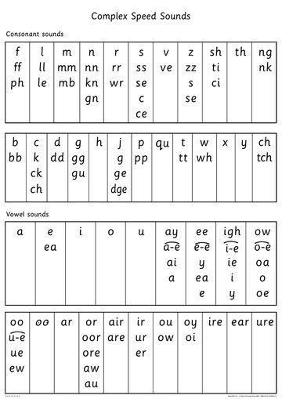
Complex Speed Sound Chart

Slide 4
RWI Assessments
Special Friend, Fred Talk Read the Word
Fred in Your Head
Speedy Reading
Fluency
Speed
Intonation
Comprehension
Results sent home after each half term assessment – sheet explained

Slide 5
Spellings
Matched to sounds they have previously learnt
Include maximum of 2 Common Exception Words. (Year One Words and Year Two Words)
Tested on Mondays - informal
New Spellings home on Mondays – Home Spelling Book (Keep in Book Bag)
Learn 3 times per week – different days
Group leader tracks scores and if they have worked on them sufficiently at home

Slide 6


Slide 7


Slide 8
Reading
During RWI time – as a whole class and with partner whilst teacher circulates
Certain children identified and read once per week with a reading volunteer/Reading buddy
Children find speedy reading words, and reading speed difficult – stumbling blocks!
1:1 Tutoring – if fall below age related expectations

Slide 9
Reading at Home
Reading at Home
Practise make Progress - assessments
5 times per week – Home/School agreement
Monitoring of Reading Records – reminder message home

Slide 10
Book bags
Reading Record – Book name, date and tick. Monitoring
Book Bag Book – shiny
Core Story Book – Floppy – Worked on in class RWI group
Sharing Book – For you to read to your child
Once completed RWI, Reading book matched to ability, and Recommended Read
Keep all in Book Bag

Slide 11



Slide 12
Reading for Pleasure
This is the aim!
Before that – share stories as much as you can
Exposure to more complex language
Pattern of a story
Inference
Comprehension
Well-Being / mental Health

Slide 13
Talk Through Stories and Class English
TTS
Vocabulary
Inference
Enjoyment!
Writing
Spelling, Grammar & Punctuation
Themes
Windows and Mirrors

Slide 14






Slide 15
https://www.thereaderteacher.com/
The Reader Teacher – Recommended reads arranged by Year Group
https://www.ruthmiskin.com/windows-and-mirrors-booklist-2/
Windows and Mirrors – Ruth Miskin book List

Slide 16

Please join your child and Read for Pleasure!

